Slide 1

Florida and Covid-19
Team 17

Slide 2
Section 1: Introduction
Notes:
Sher

Slide 3
Business Problem
- Many individuals have struggled to decide what to believe relative to protection from the virus, especially concerning the Covid-19 vaccine

Slide 4
Objective
Provide information that can be used to inform the public about the impact of vaccination status on the Covid-19 death rate so that people can make informed decisions on how to stay safe

Slide 5
Importance
Using data to recommend marketing messages
Provide educational information regarding protection
Inform decisions that will encourage/lead to higher levels of protection in their communities

Slide 6
Section 2: Data Description
Notes:
Mark

Slide 7
Data Collection Steps
Used R to scrape data from various websites
Cleaned data as it was scraped into R
Created multiple data frames
Each data frame had a county column
Used the county column to join the data frames
Notes:
Mark

Slide 8
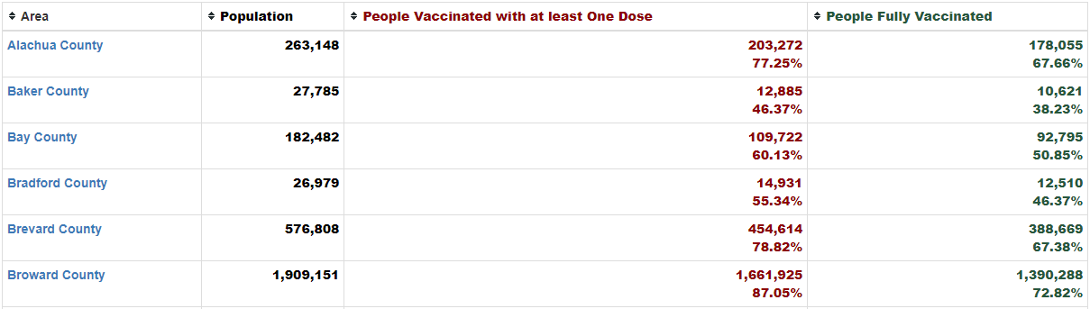
Screenshot of a Website We Scraped
https://data.democratandchronicle.com/covid-19-vaccine-tracker/florida/12/
Notes:
Mark

Slide 9
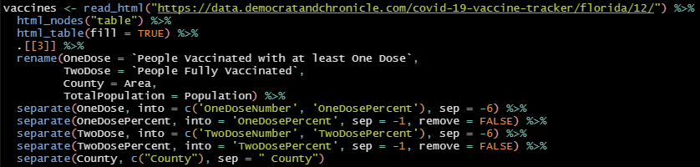

Web Scraping and Cleaning Our Data
Notes:
Mark

Slide 10
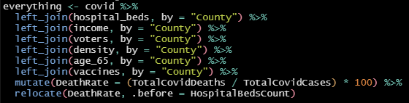
Creating Our Final Data Frame
Notes:
Mark

Slide 11
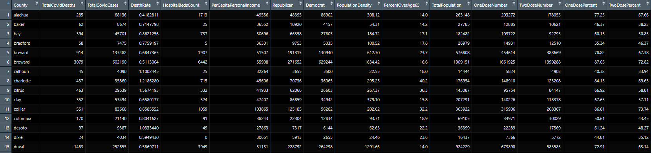
Final Data Frame
67 rows, 14 columns (not including county)
Notes:
Mark

Slide 12
Why We Chose Our Variables
Vaccines are the most protective measure from Covid-19 fatality
Elderly populations are said to be more susceptible to severe illness resulting from Covid-19 pneumonia
Severe cases go to hospitals for intensive treatment or critical care
Covid-19 is highly contagious and easily transmitted in densely populated areas
Wealthier areas may have access to better healthcare or facilities
Notes:
Mark

Slide 13
Section 3: Analysis

Slide 14
Our Question
How does vaccination status impact the total number of Covid-19 deaths per county in Florida?

Slide 15
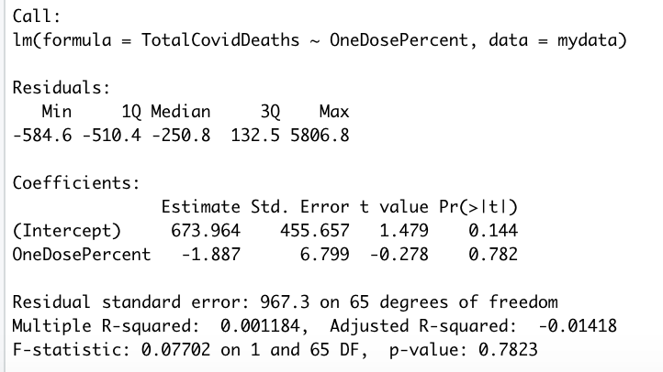
Model One: Simple Linear Regression

Slide 16
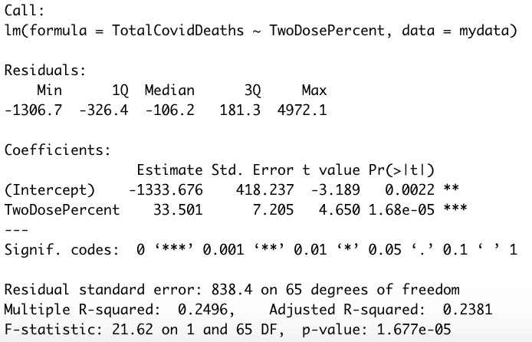
Model Two: Simple Linear Regression

Slide 17
Our New Question
How does vaccination status impact the Covid-19 death rate per county in Florida?

Slide 18
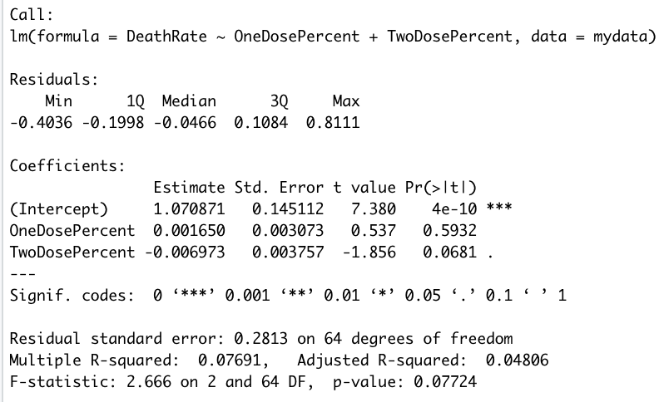
Model Three: Multiple Regression

Slide 19
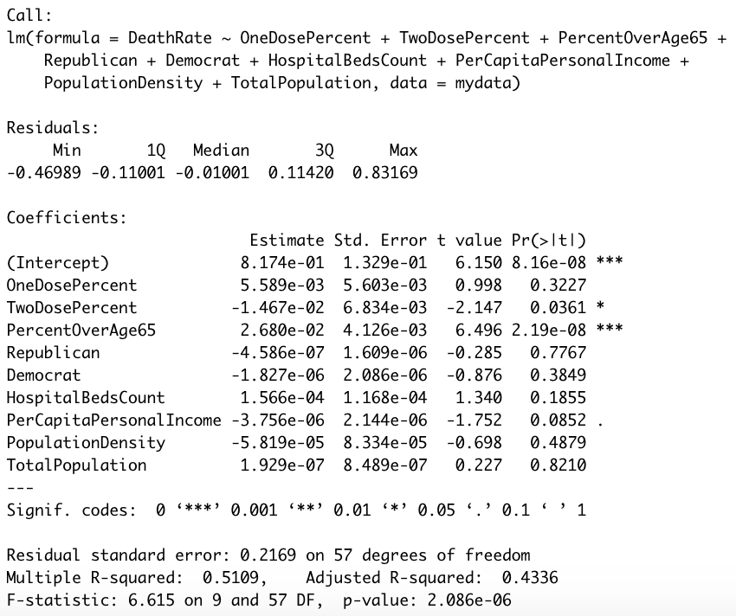
Model Four: Multiple Regression

Slide 20
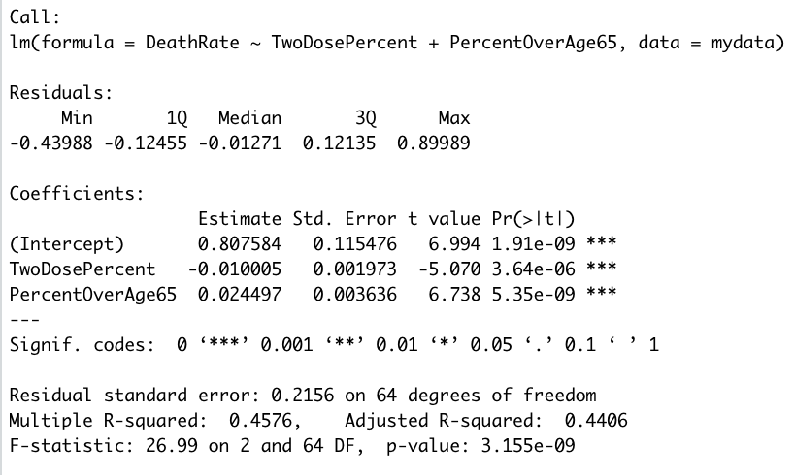
Model Five: Final Model

Slide 21
Section 4: Conclusion
Notes:
Matt

Slide 22
Strengths and Weaknesses of Our Approach
Strengths
Beta coefficients have intuitive signs
Statistically significant coefficients, p-values basically zero
Weaknesses
Could not capture all confounders
pre-existing conditions, quality of medical care, viral load per case, immunocompromised population

Slide 23
How We Will Use Our Insights
Distribute information to marketing agencies that could be contracted by local governments to:
Convince the public (people on the fence) to get vaccinated
Educate the elderly population on their increased risk of death from the Covid-19 disease
Combat misinformation with data-based evidence about the impact of vaccination status on the Covid-19 death rate

Slide 24
Final Recommendation: Using Our Insights
Using county level data in Florida:
People should receive two doses of the Covid-19 vaccine to decrease the death rate
The elderly should take extra precautions to avoid their exposure to Covid-19 since they have a higher likelihood of death from the disease

Slide 25
Summary
Initial Question
How does vaccination status impact the total number of Covid-19 deaths per county in Florida?
Web scraped our data from various websites
Built two simple regression models
Adjusted Question
How does vaccination status impact the Covid-19 death rate per county in Florida?
Final model used two key variables
Two dose percent and percent over age 65
There are confounders that we did not capture that may impact our results
E.g., health issues at the individual level (pre-existing conditions), quality of care, viral load per case, immunocompromised population

Slide 26
Data Sources
https://data.democratandchronicle.com/covid-19-vaccine-tracker/florida/12/
https://dos.myflorida.com/elections/data-statistics/voter-registration-statistics/voter-registration-reports/voter-registration-by-county-and-party/
https://fred.stlouisfed.org/release/tables?rid=175&eid=266444
https://www.indexmundi.com/facts/united-states/quick-facts/florida/percent-of-population-65-and-over#table
https://usafacts.org/visualizations/coronavirus-covid-19-spread-map/state/florida
https://worldpopulationreview.com/us-counties/states/fl

Slide 27
Thank you

Slide 28
Extra Slides: Graphical Exploration

Slide 29
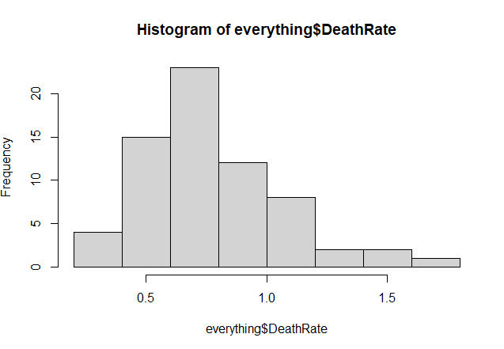
Final Model: Distribution of Death Rate

Slide 30
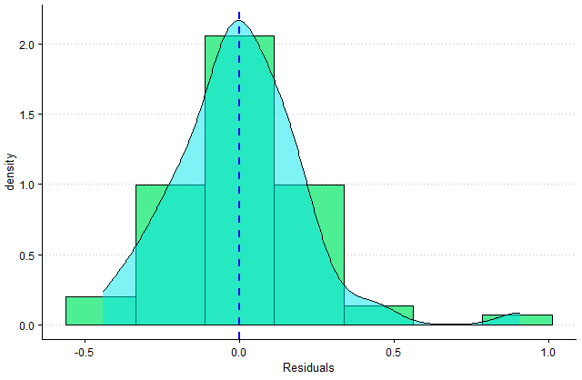
Final Model: Residual Distribution

Slide 31
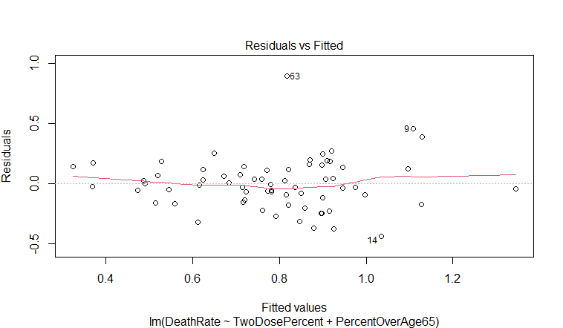
Final Model: Residuals Vs Fitted Values

Slide 32
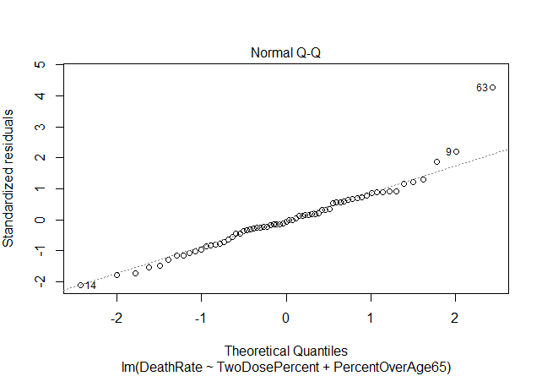
Final Model: QQ Plot

